Slide 1
NorthEast in 2020
Orion Consulting
Adam Allen
Matt Dominici
Alan Garzon
Chethan Mittapalli
Christopher Ormonde

Slide 2

Drive higher shareholder value by revolutionizing air travel to lead the no-hassle market with 4th generation aircraft technology
Year 1-2 Build infrastructure for Northeast’s future growth
Year 3-5
Pioneer 4th gen. aircraft technology and business model
Year 6-7
Seize large market share via national SkyHub expansion towards 2030
→ $50B revenues in 2030

Slide 3

Build infrastructure for Northeast’s future growth
Integrate customized Orion IT solution for increased efficiency
Hedge fuel aggressively to garner significant fuel savings
Boost load factor via customized route optimization algorithm
Implement series of no-hassle improvements for travelers
Complete 4th gen prototype to first flight readiness

Slide 4

Pioneer 4th generation aircraft technology and business model
Seize emerging no-hassle air travel market segment via disruptive innovation
Revolutionize load factor capability of aircraft with SkyHub innovation
Kickoff east coast pilot route with 3 SkyHub aircraft
Invest in point-of-service helipads in each pilot city
Track and monitor overall success of pilot program

Slide 5

Seize large market share via national SkyHub expansion towards 2030
Increase customer adoption rate through safety marketing program and high traveler satisfaction ratings
Improve national presence through tri-route U.S. expansion with 18 SkyHub aircraft
Phase out legacy airframes and processes through attrition

Slide 6
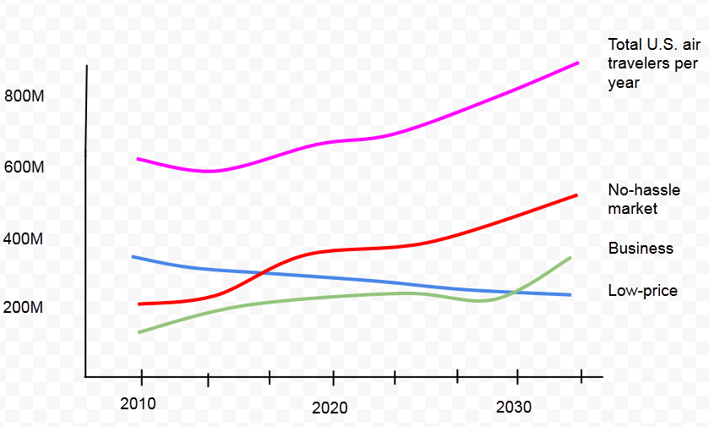
Seize emerging no-hassle air travel market segment via disruptive innovation
→ Investments to reduce hassle will yield huge future benefits
Notes:
With the economic recession behind us, more travelers are becoming more “convenience-sensitive” rather than “price-sensitive.” Northeast’s budget-pricing position will lose market share unless we capture more of the convenience market.
Our 4-year study of the airline industry, including a survey of 5,000 air travelers across 7 airlines indicates that in 2011, there were more travelers who would pay more for convenience improvements than there were who would pay more for price reductions. We have forecasted these trends to estimate that the “convenience market” will be double the “price market” by 2017, totalling about 420M travelers per year.

Slide 7
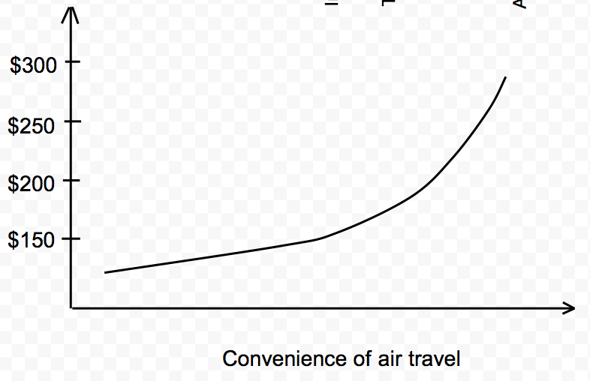
Seize emerging no-hassle air travel market segment via disruptive innovation
Customer Willingness to pay
→ Ability to reduce hassle will significantly increase customer willingness to pay
Notes:
We conducted a market survey of air travelers in 2008, 2010, and 2012 to see what they are most willing to pay more for. Our conclusion was that extremely convenient air travel would yield more willingness to pay than any other factor. We followed up with a more in depth survey to determine what “convenience factors” affected willingness to pay the most (see next slide).

Slide 8
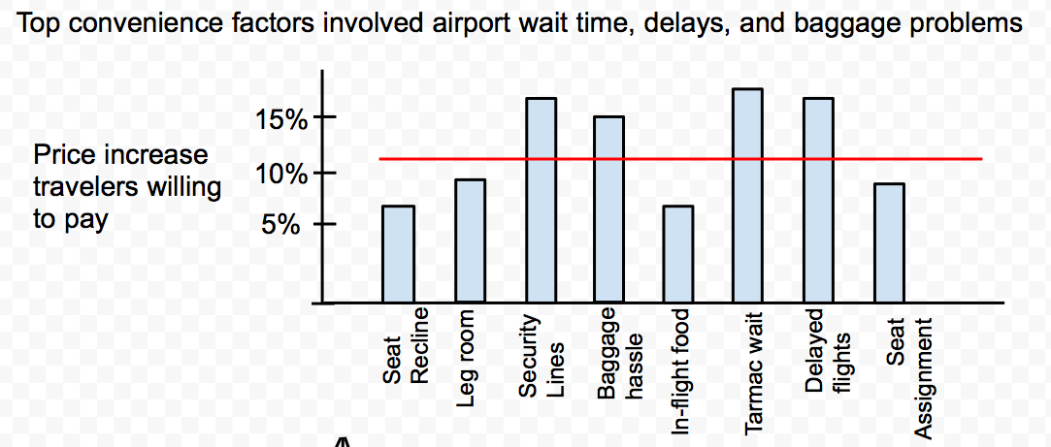
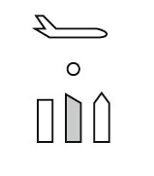
Seize emerging no-hassle air travel market segment via disruptive innovation
→ The 4 top hassles can only be solved by removing the airport
Notes:
Our findings showed that travelers are willing to pay a lot more for fewer delays and less wait time. A lot of the inconvenience of air travel, we found, is the airport’s fault, not the airlines’ fault. If we provide a solution to meet the top four convenience factors, we anticipate being able to increase our price by 35%, up from 2013’s average price of $156.
But how can travelers sidestep the airport in air travel. Impossible, you might say. Well, not for long.

Slide 9
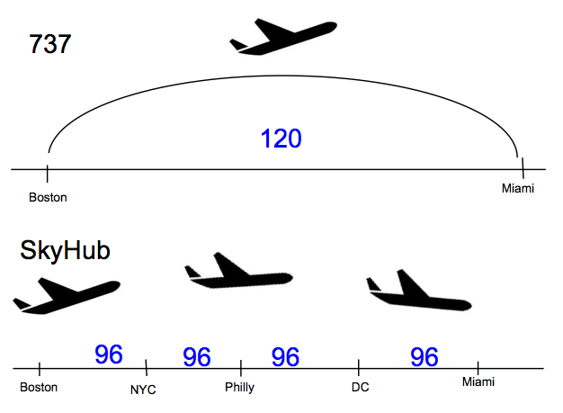
Revolutionize load factor capability of aircraft with SkyHub innovation
Attachable and detachable pax pods
High capacity
Multi-city per flight
Higher cruise speed
Improved fuel economy
Notes:
The maximum capacity for the SkyHub is over 3X the capacity of the 737. Although some passengers will fly from Boston to Miami, decreasing overall load factor, we can price our tickets accordingly to capture the full value from the customer. More variable pricing and routing means far greater optimization.

Slide 10
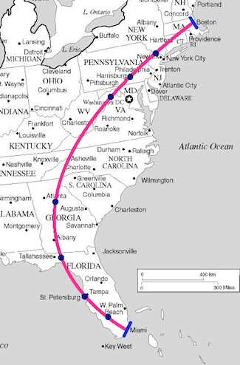
Kickoff east coast pilot route with 3 SkyHub aircraft
East coast market for 2017 pilot phase
High-volume
High city density
Multiple existing air travel hubs:
Boston, MA
New York, NY
Philadelphia, PA
Washington DC, VA
Atlanta, GA
Tallahassee, FL
Tampa, FL
W. Palm Beach, FL
Miami, FL

Slide 11
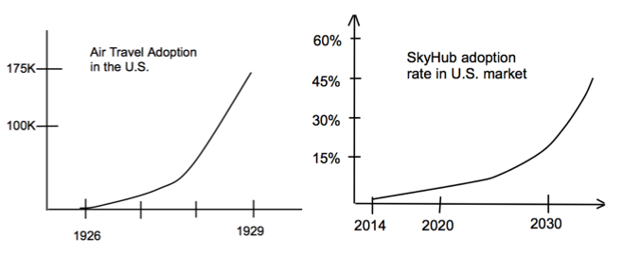
Increase customer adoption rate through safety marketing program and high traveler satisfaction ratings
→ Towards 2030,SkyHub popularity increase will lead to market dominance
Notes:
We conducted a market survey of air travelers in 2008, 2010, and 2012 to see what they are most willing to pay more for. Our conclusion was that extremely convenient air travel would yield more willingness to pay than any other factor. We followed up with a more in depth survey to determine what “convenience factors” affected willingness to pay the most (see next slide).

Slide 12
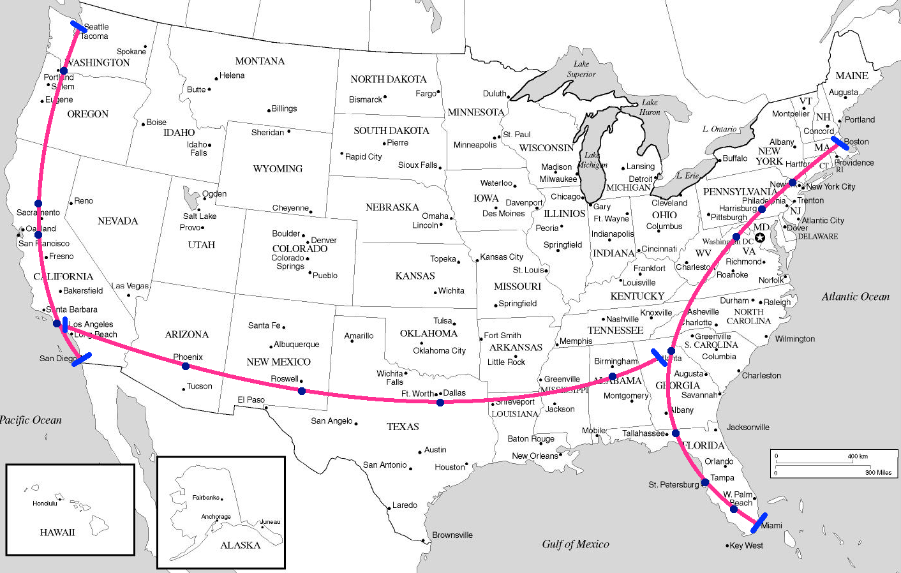
Improve national presence through tri-route U.S. expansion with 18 SkyHub aircraft
19 cities
21 SkyHubs
3 high-density routes
2 multi-hub cities:
Atlanta
Los Angeles

Slide 13
Fuel massive long term revenues through short term technology and infrastructure investments
Route optimization
→ Continued SkyHub Route Rollouts
IT
Fuel
Pilot
Total 2020 Revenue: $29B Increase: $12B Profit: $3B
Short-term Infrastructure
Total Asset Investment: $5.5B
R&D
SkyHub Pilot
(3 aircraft)
Buy 6 SkyHubs
Buy 6 SkyHubs
Buy 6 SkyHubs
Notes:
Probably most important slide. We need to lay out what investments NE will need to make and the timing of revenues. Then a basic DCF to get net present value, then divide by total shares to get new share price.

Slide 14
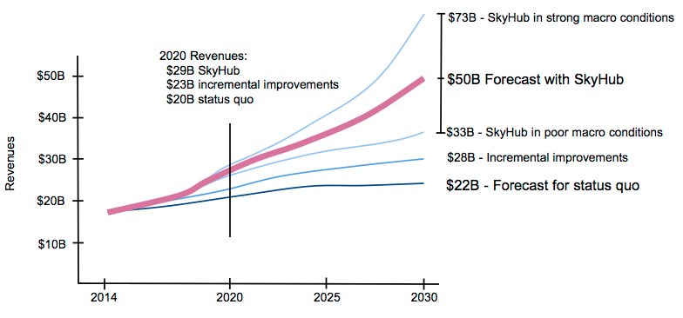
Dominate future air travel market through near-term investment in SkyHub technology and infrastructure

Slide 15
Drive shareholder value by 3x through SkyHub innovation
 | Revenues | Profit Margin | Share Price
Current | $17B | 5% | $21.20
2020 | $29B | 9% | $32
2030 | $50B | 18% | $62
→ Partner with Orion to revolutionize NorthEast for the future
Notes:
Innovative payment system?

Slide 16
Questions ?

Slide 17
Integrate customized Orion IT solution for increased efficiency
 | Outsource | Acquire | Internal | Orion
Cost | 4 | 2 | 1 | 3
Integration/ Compatibility | 1 | 2 | 5 | 4
Time to Implement | 2 | 1 | 1 | 4
Data Center Capacity | 3 | 3 | 3 | 3
Security | 1 | 3 | 3 | 4
Real-Time Updates | 1 | 3 | 3 | 5
→ Orion IT system provides the best ROI
Notes:
We looked into several options including outsourcing, acquiring a system, having Northeast creating a system internally, and also the option of using our customizable system created by our Aviation team. We formed this system by developing a best set of practices through consulting on and studying similar systems in several industries including airline, rail, car rentals, and hotel bookings.
-Rated from 1-5, with 1 being worst and 5 being best.
If we acquire or outsource – we’d need to buy several systems. One for baggage improvements, one for reservations, etc. Our system has it all under one roof.
-With this system, we project a 55% increase in savings over the next 10 years.
-Should significantly decrease Wilma’s costs.
-Will only need half of the 260 luggage people you hired – exponential savings, but given the culture of NorthEast, I’ll let you decide. We would recommend you let them go.

Slide 18
Hedge fuel aggressively to garner significant fuel savings
Alternative Fuel Solutions
Investment
Orion Fuel Hedging Market Analytics Prediction System
Bulk Purchasing
NE Status Quo
Profits
Notes:
-For fuel savings, we considered three different options: Bulk purchasing, Alternative Fuel solutions such as synthetic fuels,biofuels,biodiesel and advanced fuel hedging data analytics system.
- we have an advanced data analytics fuel hedging system that can predict fuel hedging ratios based on market conditions, economic factors, commodity fluctuations etc used in airline industry.
NE is already doing hedging but our system can increase the fuel savings significantly compared to the existing hedging methodology by more than 40% increase in fuel cost savings.
-We can completely customize this to NorthEast’s needs, and give you exclusivity on it going forward as this is considered best of the industry.
- NE strategy of fuel hedging is consistent with current strategy and NE already saved more than $3.7 B in last 10 years.
-We recommend that fuel hedging should be major tactic for fuel savings based on costs and profits analysis. But, making small bets on alternative fuel solutions would be good for future as demand for alternative fuel flights are growing and our new flight can support such fuels in the long run.

Slide 19
Boost load factor via customized route optimization algorithm
OUTSOURCE
ORION
Minimize Costs
ACQUIRE
CURRENT
Maximize Profits
Notes:
-Once again, we had a similar set of options: outsource, acquire, internal or use ours.
-Using this software, we should be able to boost load factor by 5 points. That’s about $560 million.
-Through years of work, our aviation team has created the most advanced algorithm in the industry for route optimization. We can completely customize this to NorthEast’s needs, and give you exclusivity on it going forward.
-We’ve done several case studies on this, and it has worked every time.

Slide 20
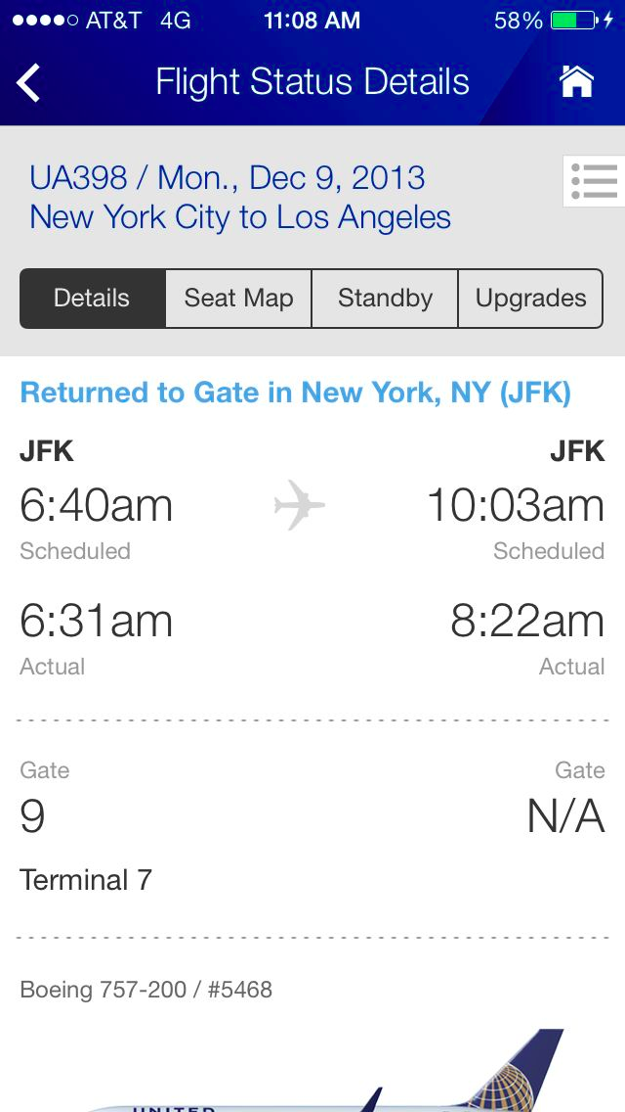
Implement series of no-hassle improvements for travelers
Automate baggage check-in
Check in for flights via mobile app
Optimized seating and boarding system
Dedicated NorthEast parking area at terminal
Notes:
Optimized seating/boarding - if someone doesn’t have luggage, they get on first. Reduces total boarding time (bottleneck) and makes customers more satisfied with lack of hassle of boarding.

Slide 21
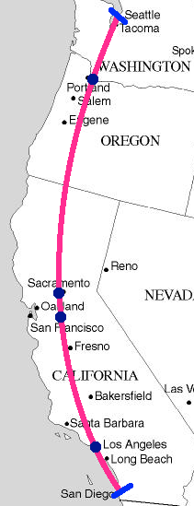
Route 2
Seattle, WA
Portland, OR
Sacramento, CA
San Francisco, CA
Los Angeles, CA
San Diego, CA

Slide 22
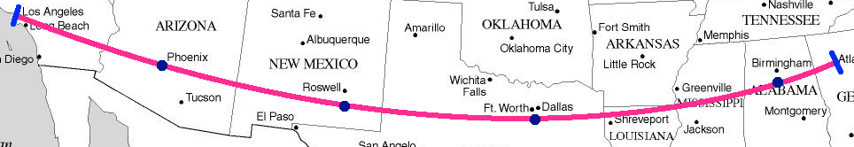
Route 3
Los Angeles, CA
Phoenix, AZ
Roswell, NM
Dallas, TX
Birmingham, AL
Atlanta, GA

